Slide 1
HOW TO ENROLL IN YOUR SECTION
Step 1: Must confirm your correct section number by your instructor.
Step 2: Login to blackboard (www.bb.uob.bh)

Slide 2
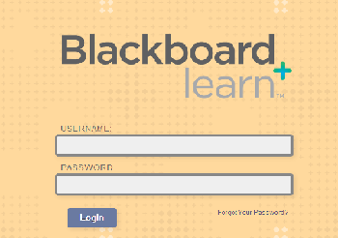
USERNAME and PASSWORD is same as you received from registration office.

Slide 3
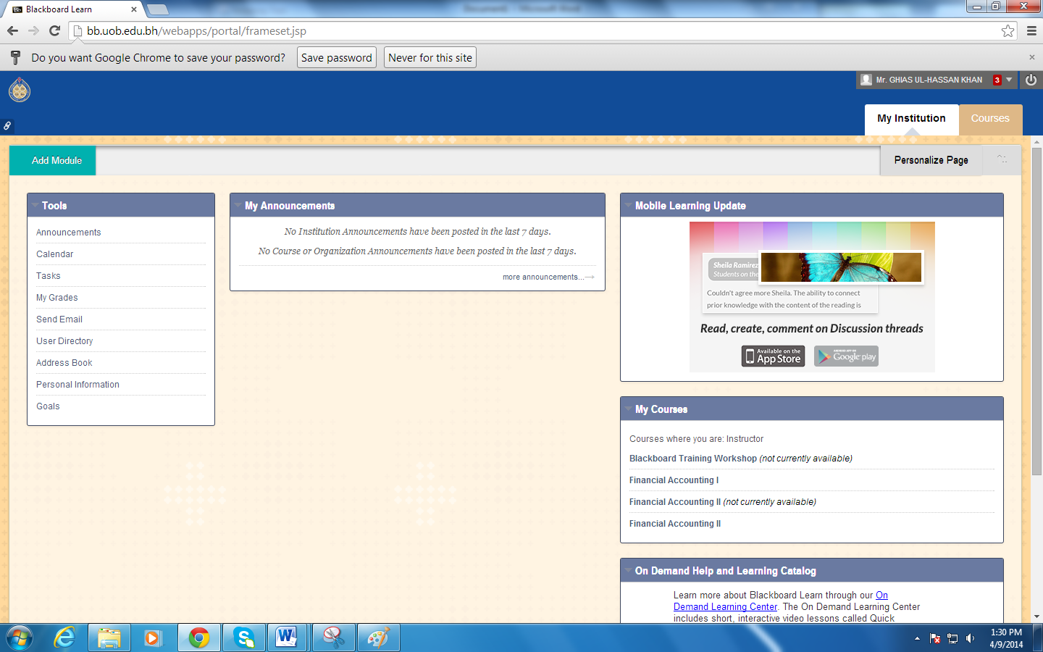
Step 3: Click on courses and select your course

Slide 4
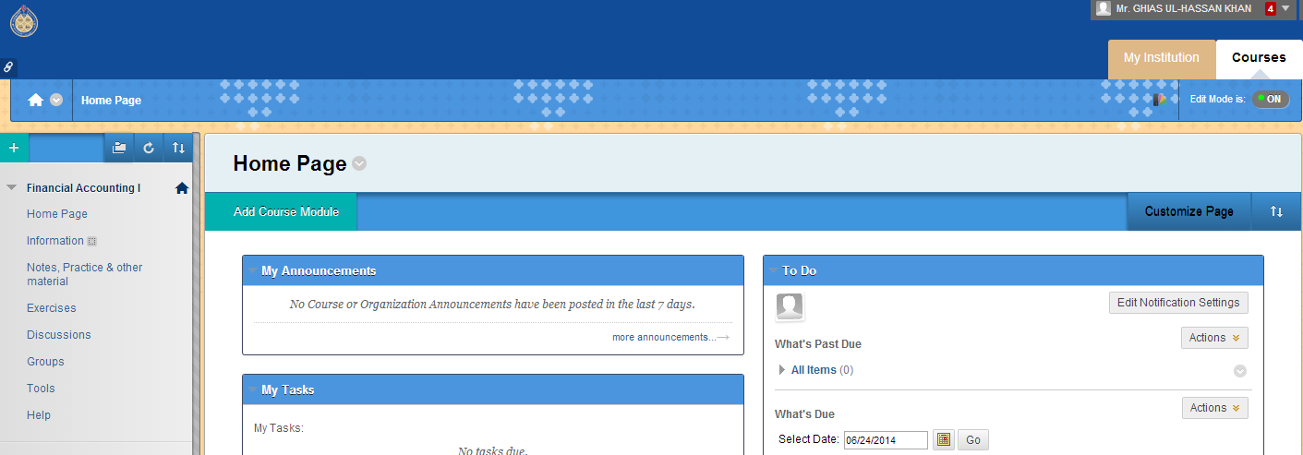
Step 4: Click on groups from the course section

Slide 5
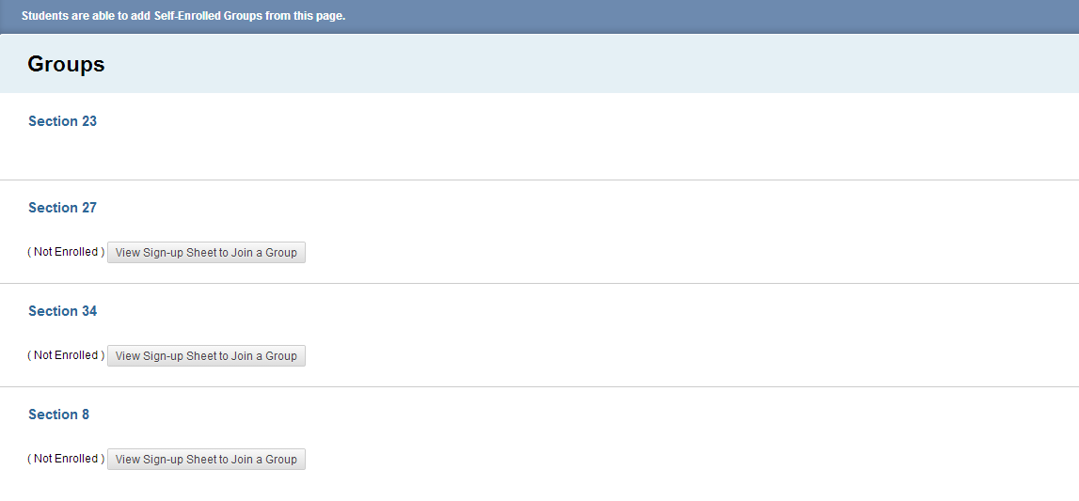
Step5 : From the group section click on view sign-up sheet to join a group of your section

Slide 6
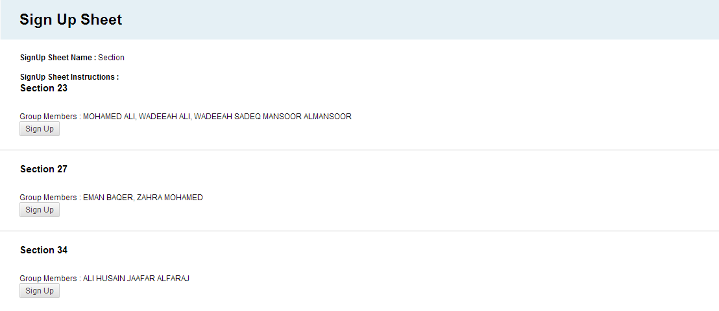
Step 6: From the below sign-up sheet click on the sign up under your section number

Slide 7
NOW
You are enrolled
Just inform your doctor that you performed the task.

